Slide 1
Objectives
I can explain the basic fighting and military goals in the Pacific Theatre.
I can explain Japan’s rise to power and the consequences of their takeover in Asia, specifically the Rape of Nanking.

Slide 2
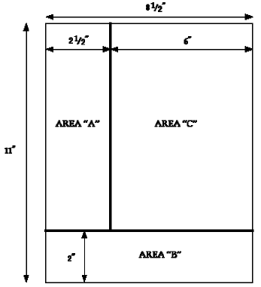
Essential Question/Standard
How did the Japanese rise to power? What were the consequences of their takeover? (Page 133)

Slide 3
Japan’s Rise to Power
WWI- gained power in China and Pacific
Russo-Japanese War- dominant power in Korea and Manchuria
Gradually became a military dictatorship

Slide 4
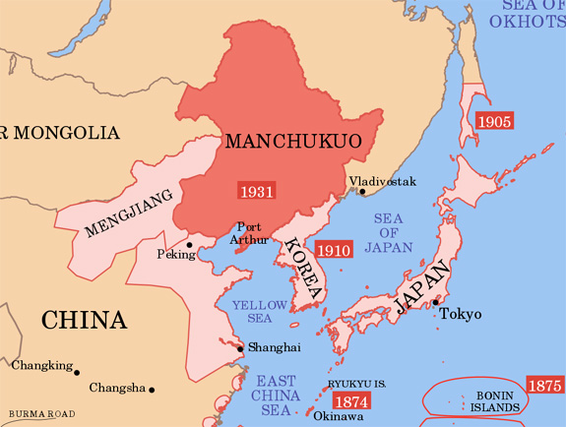
Japan vs. China
1931- Fighting in Manchuria
Little response from League of Nations, withdrew
1937- At war with China

Slide 5
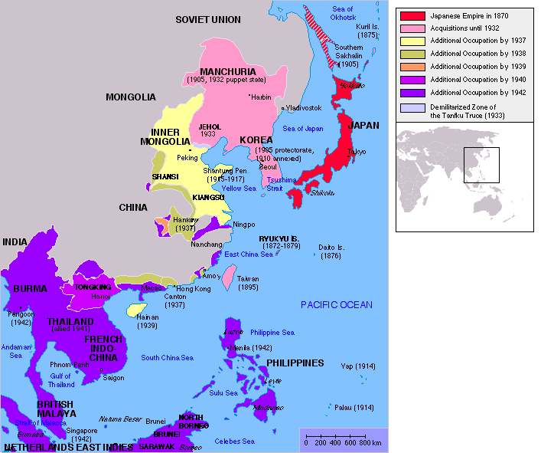
Involvement in SE Asia
Sanctions from US = turn to SE Asia for raw materials, lead to decision to attack Pearl Harbor

Slide 6
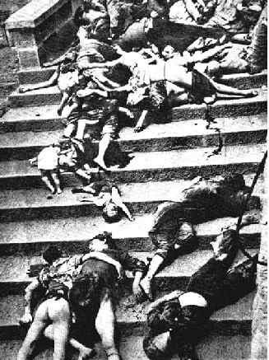
Rape of Nanking
Japanese atrocities committed in Nanking in 1938/1938
300,000 deaths

Slide 7
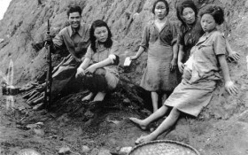
Comfort Women
Young women from Korea, China, Philippines, forced to become slave-prostitutes for the Japanese soldiers

Slide 8
Comfort Women
Video Clip-
http://www.youtube.com/watch?v=V-UwU1-RVWs

Slide 9
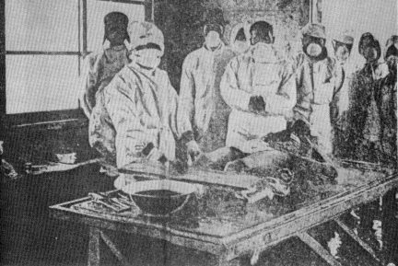
Unit 731
Carried out medical experiments on slave laborers, women and children

Slide 10
Unit 731
Video Clip- http://www.youtube.com/watch?v=D7yDOXGmtro

